Slide 1



Department of IT Engineering
Chapter 5
Greedy Algorithms
Subject Code: 01CE0503
Design and Analysis of Algorithm (DAA)
Prof. Yatri Davda

Slide 2

Outline
General Characteristics of greedy algorithms
Elements of Greedy Strategy
The Fractional Knapsack Problem
Activity selection problem
Job Scheduling Problem
Looping

Slide 3
Introduction

Slide 4
Characteristics of Greedy Algorithms
Greedy algorithms are characterized by the following features.
Greedy approach forms a set or list of candidates 𝑪.
Once a candidate is selected in the solution, it is there forever: once a candidate is excluded from the solution, it is never reconsidered.
To construct the solution in an optimal way, Greedy Algorithm maintains two sets.
One set contains candidates that have already been considered and chosen, while the other set contains candidates that have been considered but rejected.
The greedy algorithm consists of four functions.
Solution Function:- A function that checks whether chosen set of items provides a solution.
Feasible Function:- A function that checks the feasibility of a set.
Selection Function:- The selection function tells which of the candidates is the most promising.
Objective Function:- An objective function, which does not appear explicitly, but gives the value of a solution.

Slide 5
Knapsack Problem

Slide 6
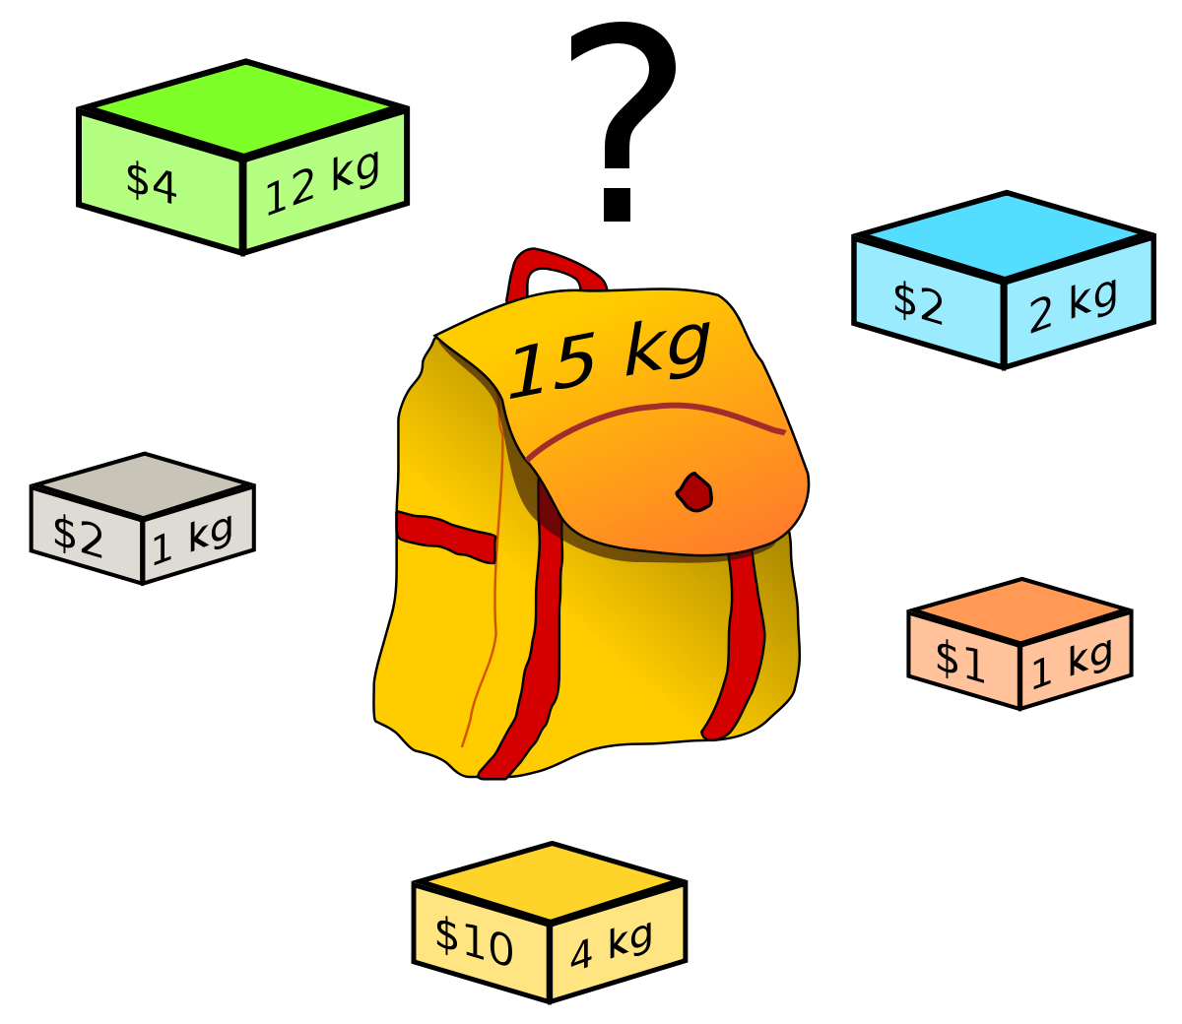
Knapsack Problem

Slide 7
Fractional Knapsack Problem

Slide 8
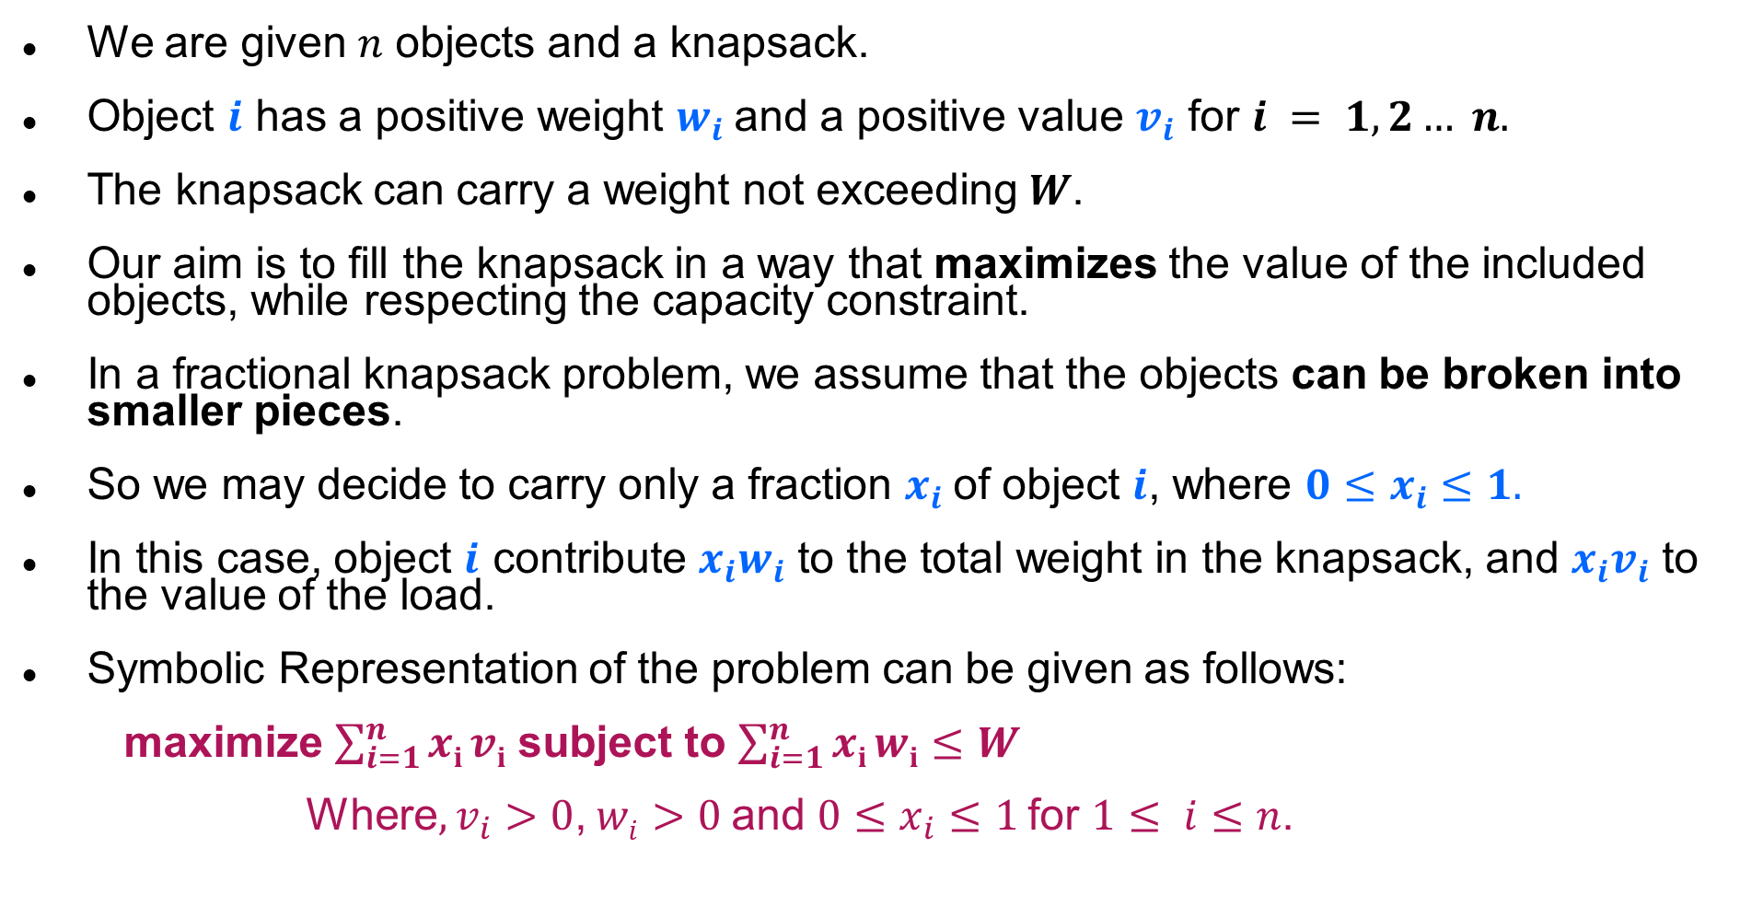
Introduction
We are given $n$ objects and a knapsack.
Object $i$ has a positive weight $w_{i}$and a positive value $v_{i}$ for $i = 1, 2… n.$
The knapsack can carry a weight not exceeding $W$.
Our aim is to fill the knapsack in a way that maximizes the value of the included objects, while respecting the capacity constraint.
In a fractional knapsack problem, we assume that the objects can be broken into smaller pieces.
So we may decide to carry only a fraction $x_{i}$of object $i$, where $0≤x_{i}≤1.$
In this case, object $i$ contribute $x_{i}w_{i}$ to the total weight in the knapsack, and $x_{i}v_{i}$ to the value of the load.
Symbolic Representation of the problem can be given as follows:
maximize $\sum_{i=1}^{n}{xi}vi$ subject to $\sum_{i=1}^{n}{xi}wi$ $≤W$
Where$, v_{i}>0$, $wi>0$and $0≤x_{i}≤1$for $1≤ i≤n$.

Slide 9
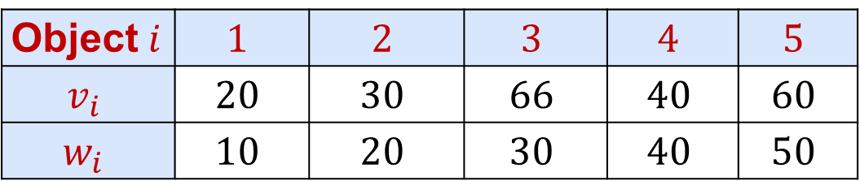
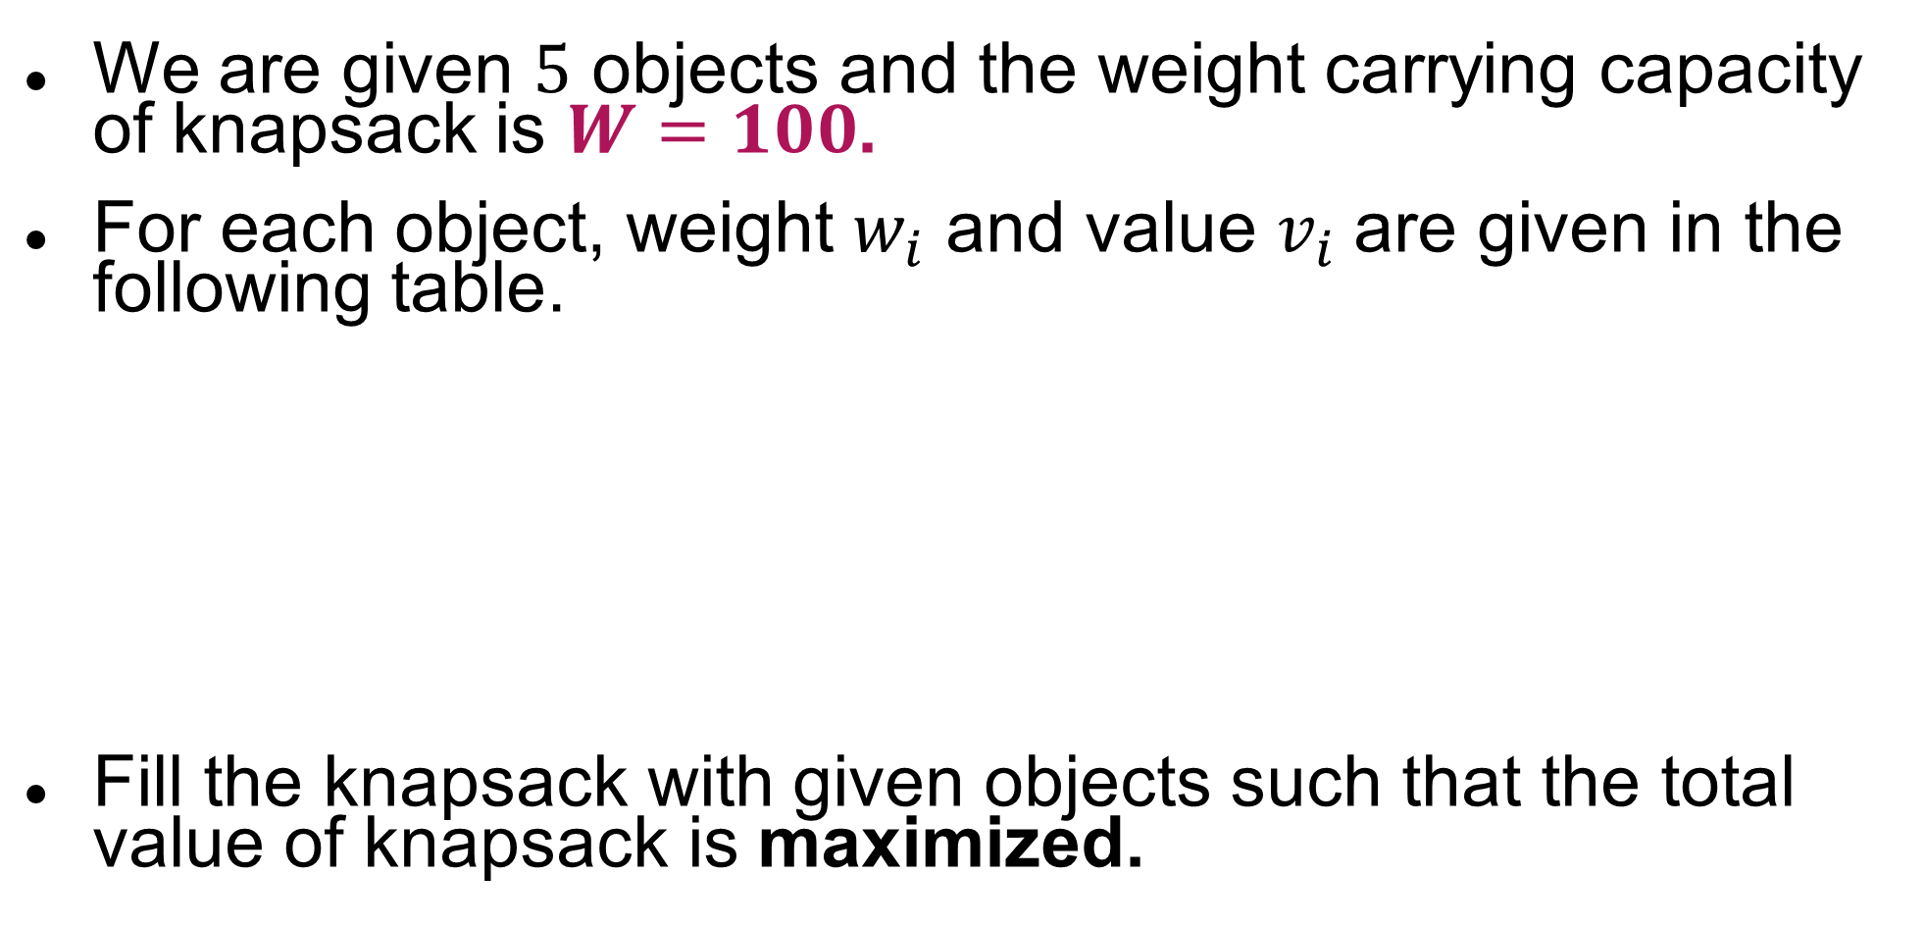
Fractional Knapsack Problem - Example
We are given $5$ objects and the weight carrying capacity of knapsack is $W=100$.
For each object, weight $w_{i}$ and value $v_{i}$are given in the following table.
Fill the knapsack with given objects such that the total value of knapsack is maximized.
Object$i$ | $$1$$ | $$2$$ | $$3$$ | $$4$$ | $$5$$
$$v_{i}$$ | $$20$$ | $$30$$ | $$66$$ | $$40$$ | $$60$$
$$w_{i}$$ | $$10$$ | $$20$$ | $$30$$ | $$40$$ | $$50$$

Slide 10
Fractional Knapsack Problem - Greedy Solution
Three Selection Functions can be defined as,
Sort the items in descending order of their values and select the items till weight criteria is satisfied.
Sort the items in ascending order of their weight and select the items till weight criteria is satisfied.
To calculate the ratio value/weight for each item and sort the item on basis of this ratio. Then take the item with the highest ratio and add it.

Slide 11
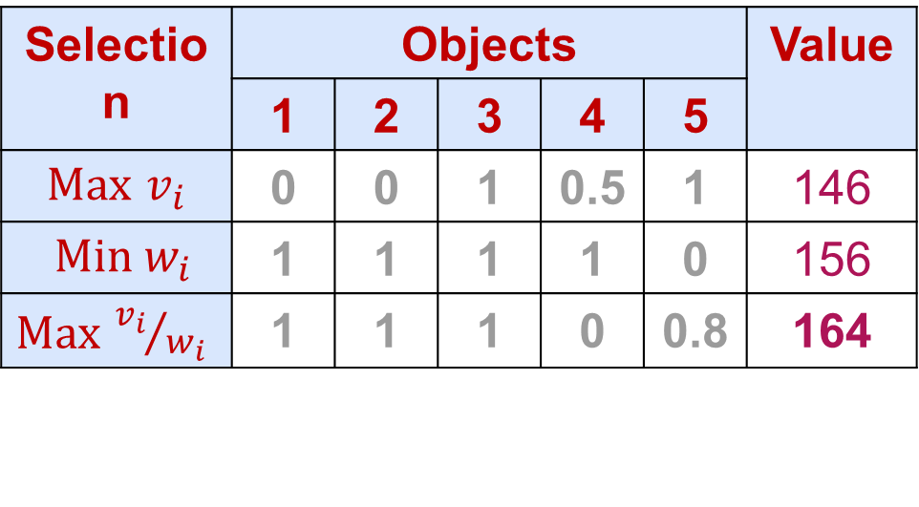
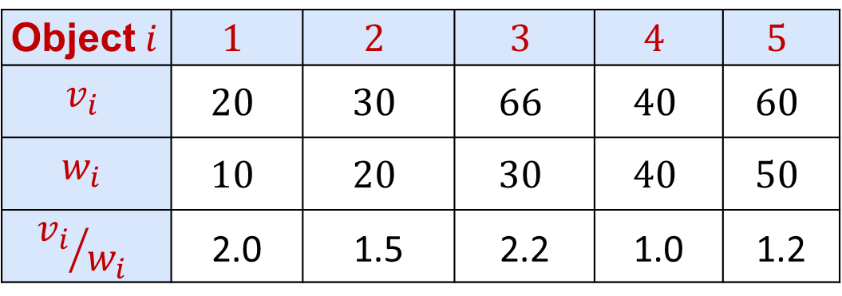
Fractional Knapsack Problem - Greedy Solution
Object$i$ | $$1$$ | $$2$$ | $$3$$ | $$4$$ | $$5$$
$$v_{i}$$ | $$20$$ | $$30$$ | $$66$$ | $$40$$ | $$60$$
$$w_{i}$$ | $$10$$ | $$20$$ | $$30$$ | $$40$$ | $$50$$
$${v_{i}}/{w_{i}}$$ | 2.0 | 1.5 | 2.2 | 1.0 | 1.2
Selection | Objects |  |  |  |  | Value
 | 1 | 2 | 3 | 4 | 5
$Max$ $v_{i}$ | 0 | 0 | 1 | 0.5 | 1 | 146
$Min w_{i}$ | 1 | 1 | 1 | 1 | 0 | 156
$Max$ ${v_{i}}/{w_{i}}$ | 1 | 1 | 1 | 0 | 0.8 | 164
Weight Capacity 100
30
50
20
10
20
30
40
30
10
20
40
Profit = 66 + 20 + 30 + 48 = 164
Profit = 66 + 60 + (40 * 0.5) = 146
Profit = 20 + 30 + 66 + 40 = 156

Slide 12
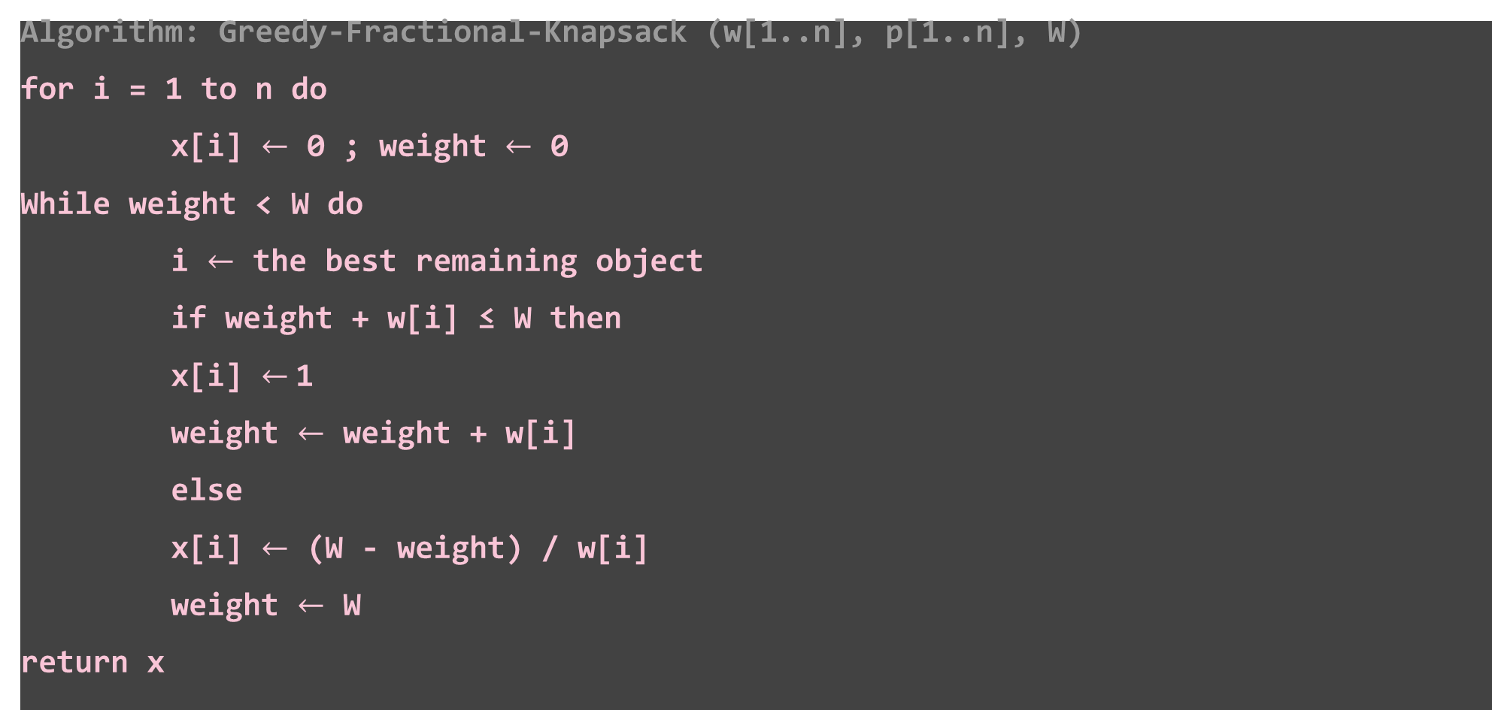
Fractional Knapsack Problem - Algorithm
Algorithm: Greedy-Fractional-Knapsack (w[1..n], p[1..n], W)
for i = 1 to n do
x[i] $←$ 0 ; weight $←$ 0
While weight < W do
i $←$ the best remaining object
if weight + w[i] ≤ W then
x[i] $←$1
weight $←$ weight + w[i]
else
x[i] $←$ (W - weight) / w[i]
weight $←$ W
return x
W = 100 and Current weight in knapsack= 60
Object weight = 50
The fraction of object to be included will be
(100 – 60) / 50 = 0.8

Slide 13
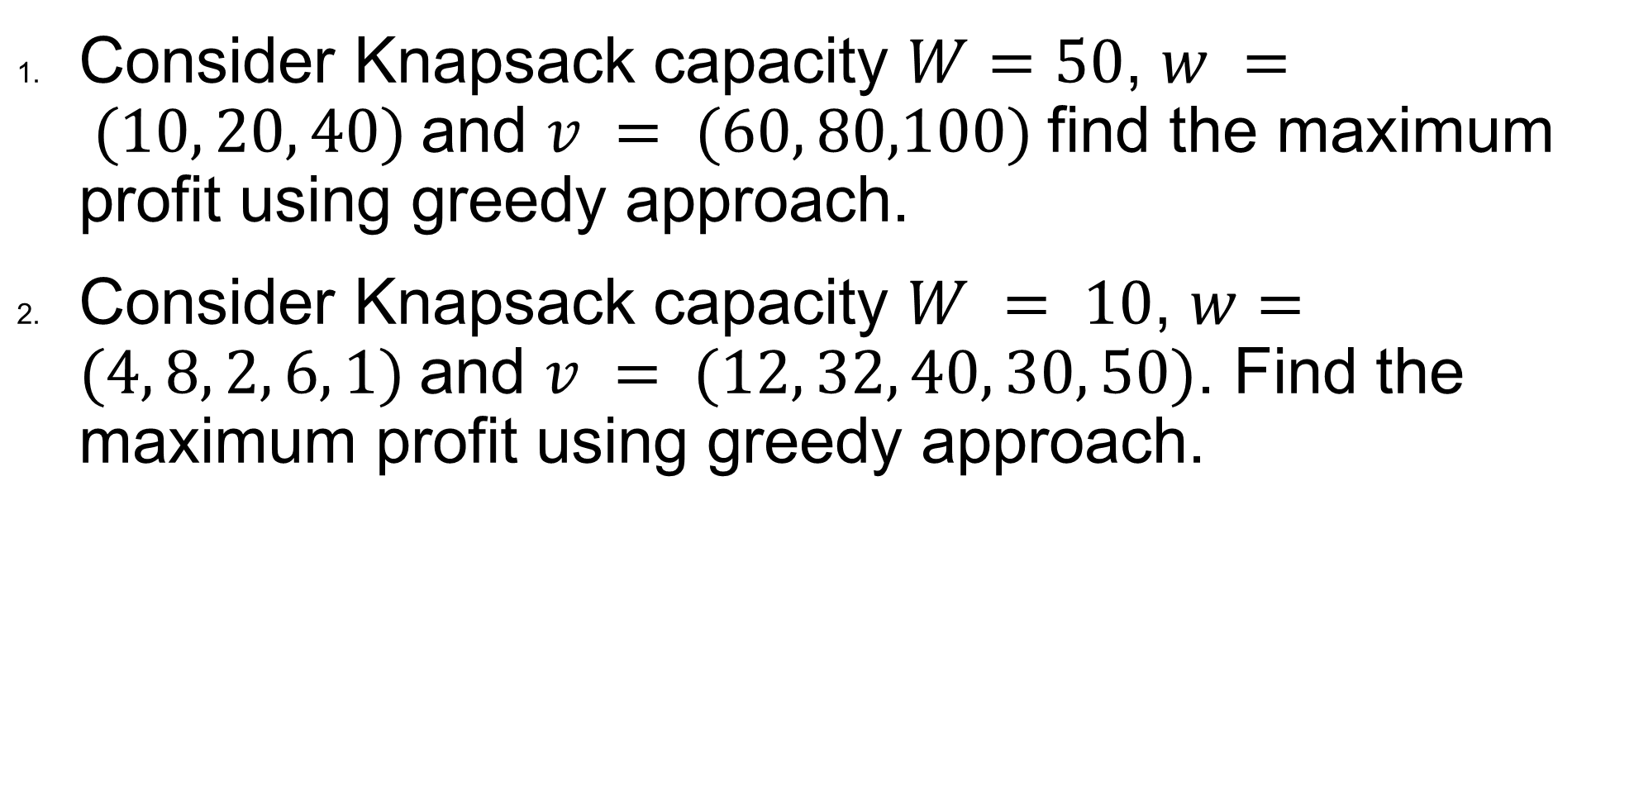
Exercises – Home Work
Consider Knapsack capacity $W=50$, $w = (10, 20, 40)$and $v = (60, 80,100)$find the maximum profit using greedy approach.
Consider Knapsack capacity $W = 10$, $w=(4, 8, 2, 6, 1)$and $v = (12, 32, 40, 30, 50)$. Find the maximum profit using greedy approach.

Slide 14
Activity Selection Problem

Slide 15
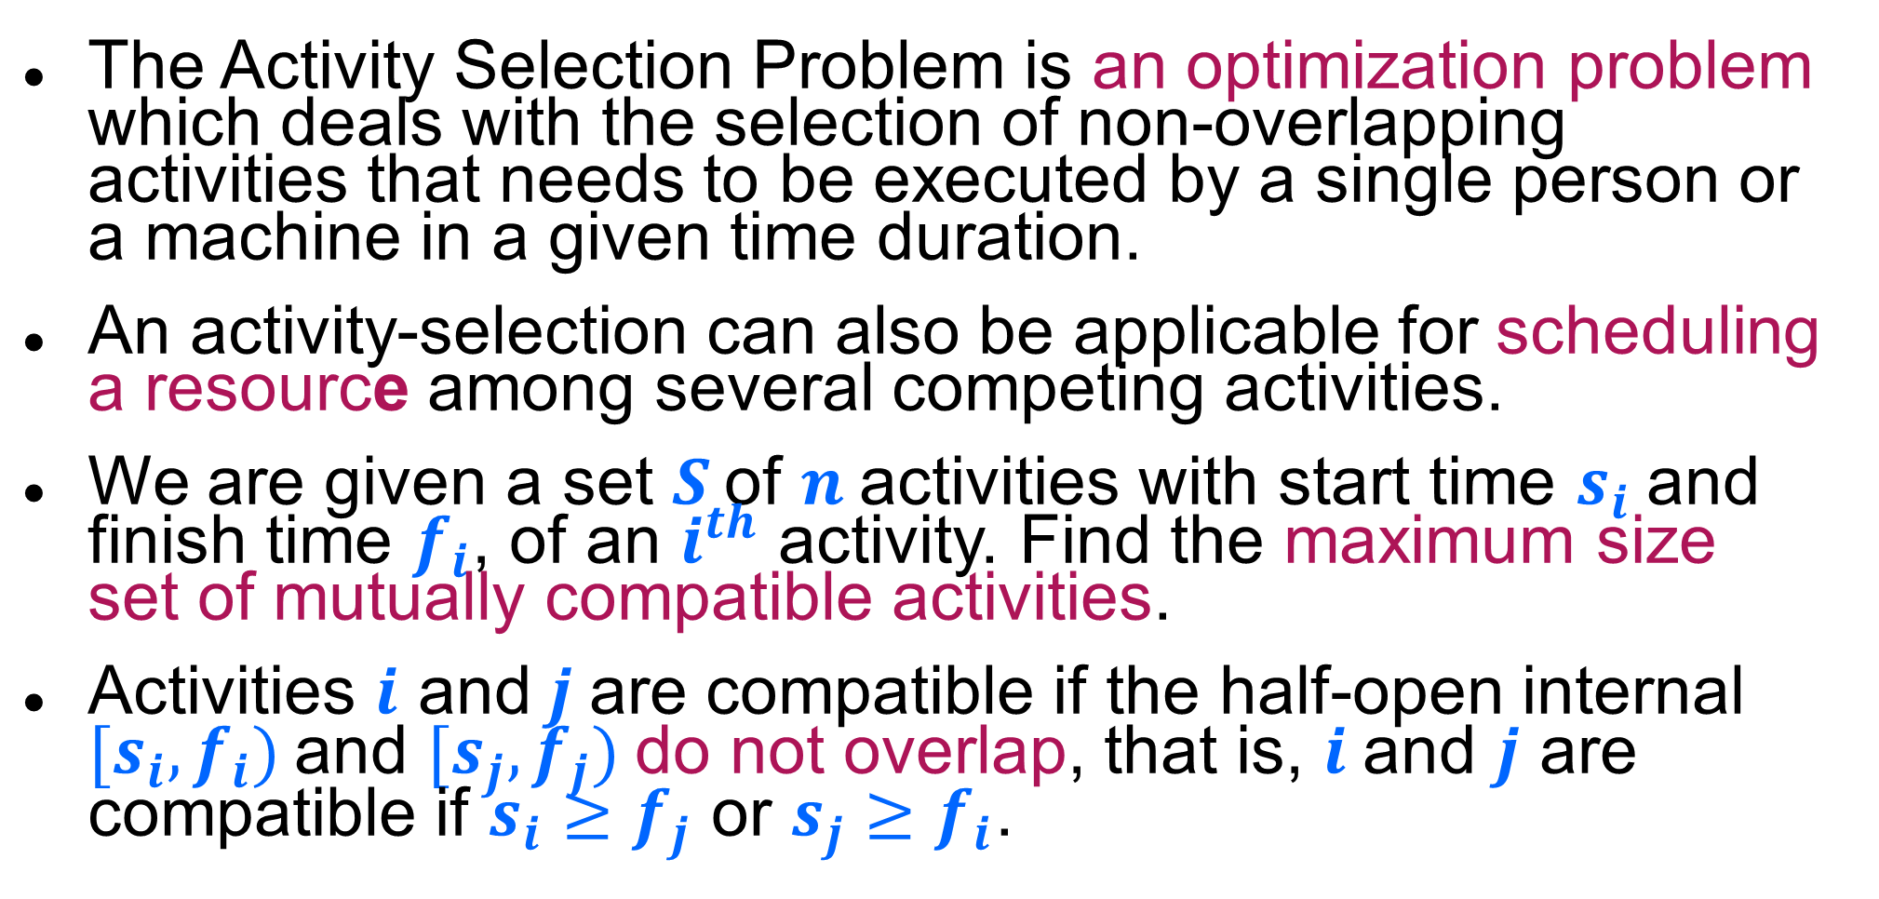
Introduction
The Activity Selection Problem is an optimization problem which deals with the selection of non-overlapping activities that needs to be executed by a single person or a machine in a given time duration.
An activity-selection can also be applicable for scheduling a resource among several competing activities.
We are given a set $S$ of $n$activities with start time $s_{i}$and finish time $f_{i}$, of an $i^{th}$ activity. Find the maximum size set of mutually compatible activities.
Activities $i$ and$j$are compatible if the half-open internal $[s_{i},f_{i})$and $[s_{j},f_{j})$do not overlap, that is, $i$ and $j$ are compatible if $s_{i}≥f_{j}$ or $s_{j}≥f_{i}$.

Slide 16
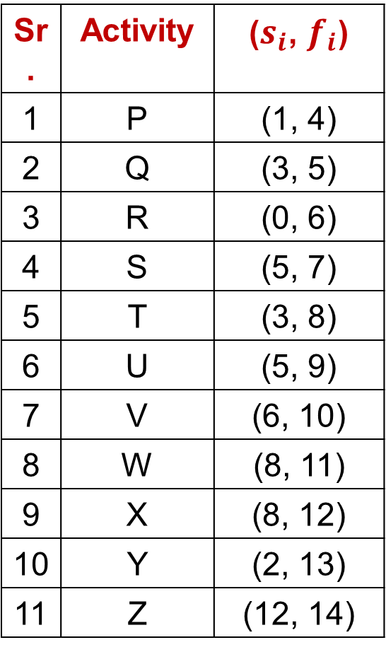
Activity Selection Problem - Example
Sr. | Activity | ($s_{i}$, $f_{i}$)
1 | P | (1, 4)
2 | Q | (3, 5)
3 | R | (0, 6)
4 | S | (5, 7)
5 | T | (3, 8)
6 | U | (5, 9)
7 | V | (6, 10)
8 | W | (8, 11)
9 | X | (8, 12)
10 | Y | (2, 13)
11 | Z | (12, 14)
Example: 11 activities are given as,
Solution:
Step 1:
Sort the activities of set 𝑺 as per increasing finish time to directly identify mutually compatible activities by comparing finish time of first activity and start time of next activity

Slide 17
Activity Selection Problem - Example
Sr. | Activity | ($s_{i}$, $f_{i}$)
1 | P | (1, 4)
2 | Q | (3, 5)
3 | R | (0, 6)
4 | S | (5, 7)
5 | T | (3, 8)
6 | U | (5, 9)
7 | V | (6, 10)
8 | W | (8, 11)
9 | X | (8, 12)
10 | Y | (2, 13)
11 | Z | (12, 14)
Example: 11 activities are given as,
Solution:
Step 2:
A = {P}
A = {P, S}
A = {P, S, W}
A = {P, S, W, Z}
Answer: A = {P, S, W, Z}

Slide 18
Activity Selection - Algorithm
Algorithm: Activity Selection
Step I: Sort the input activities by increasing finishing time. f₁ ≤ f₂ ≤ . . . ≤ f_{n}
Step II: Call GREEDY-ACTIVITY-SELECTOR (s, f)
n = length [s]
A = {i}
j = 1
for i = 2 to n
do if s_{i} ≥ f_{j}
then A = A U {i}
j = i
return set A

Slide 19
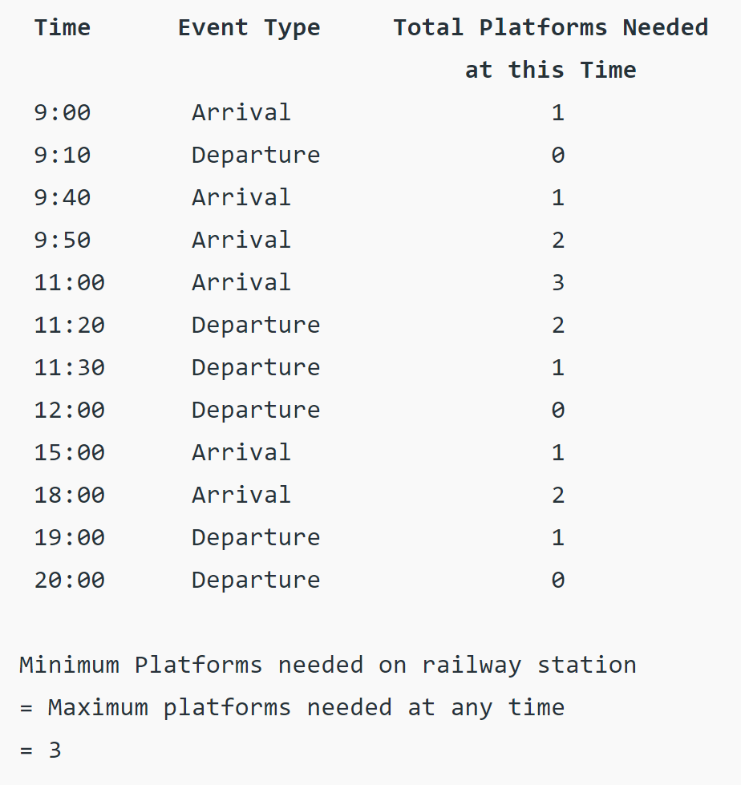
Exercise - HW
Given arrival and departure times of all trains that reach a railway station, find the minimum number of platforms required for the railway station so that no train waits. We are given two arrays which represent arrival and departure times of trains that stop. Arr[ ] = {9:00, 9:40, 9:50, 11:00, 15:00, 18:00} dep[ ] = {9:10, 12:00, 11:20, 11:30, 19:00, 20:00}

Slide 20
Job Scheduling with Deadlines

Slide 21
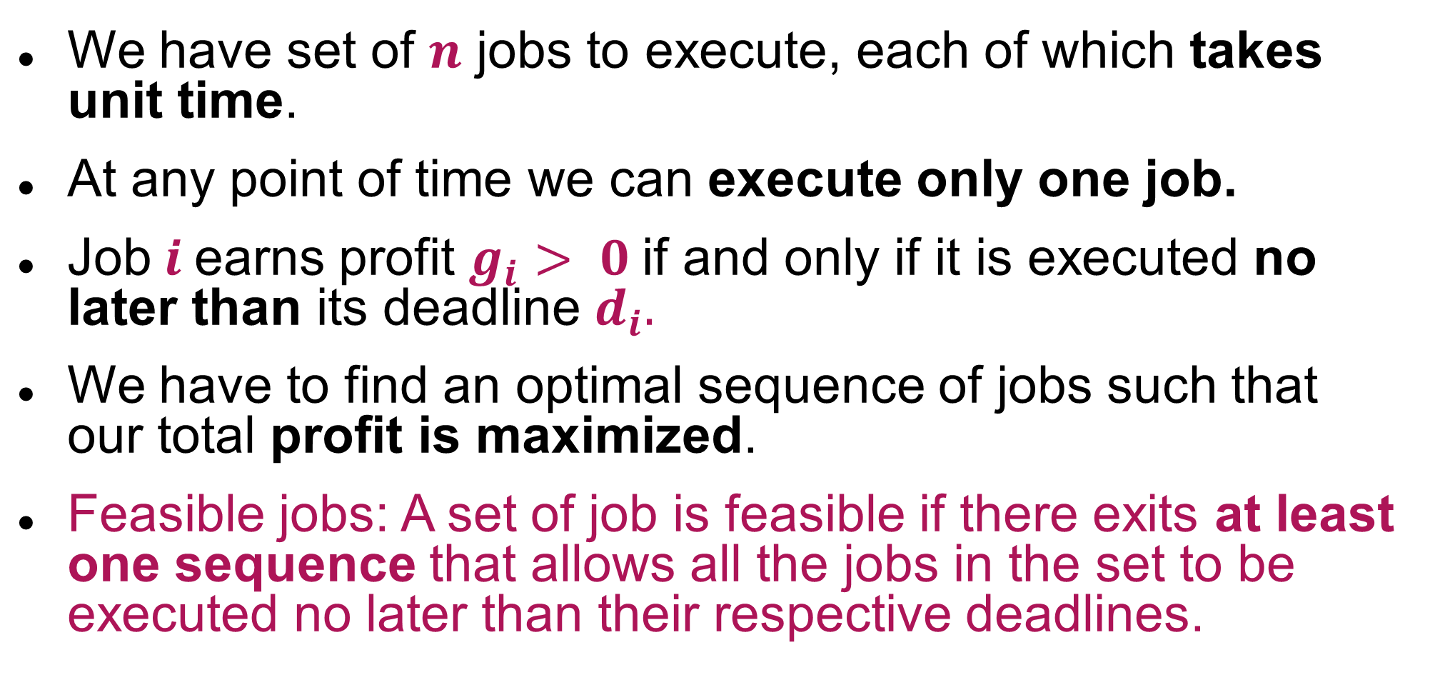
Introduction
We have set of $n$ jobs to execute, each of which takes unit time.
At any point of time we can execute only one job.
Job$i$earns profit $g_{i}> 0$if and only if it is executed no later than its deadline $d_{i}.$
We have to find an optimal sequence of jobs such that our total profit is maximized.
Feasible jobs: A set of job is feasible if there exits at least one sequence that allows all the jobs in the set to be executed no later than their respective deadlines.

Slide 22
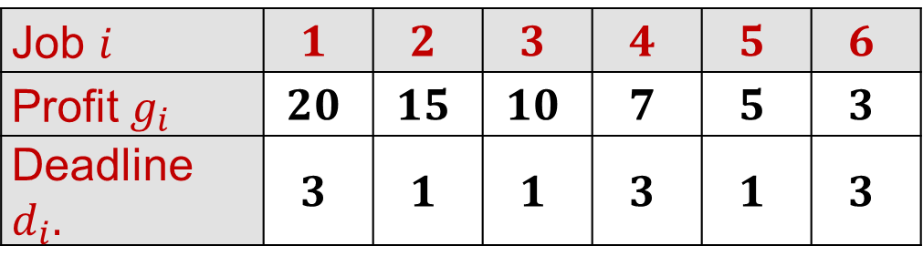
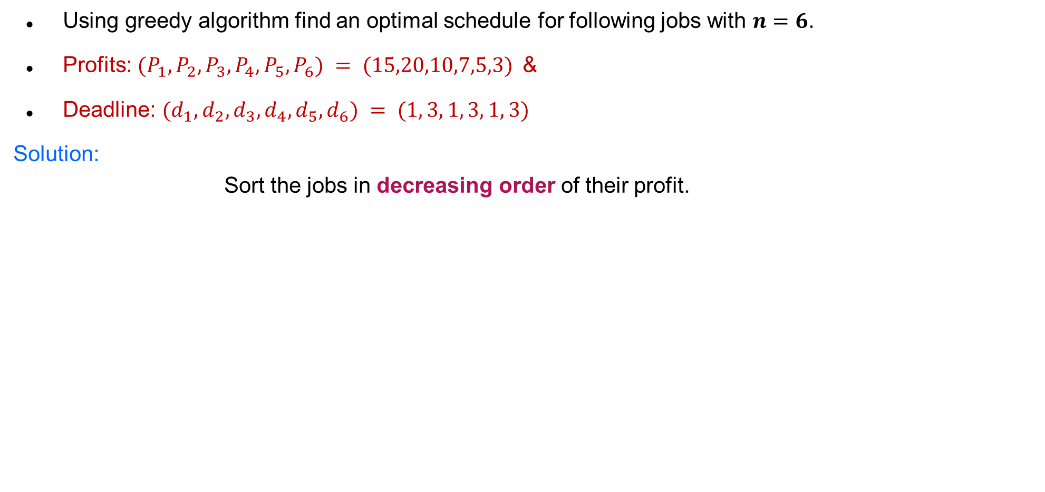
Job Scheduling with Deadlines - Example
Using greedy algorithm find an optimal schedule for following jobs with $n=6$.
Profits: $(P_{1},P_{2},P_{3},P_{4},P_{5},P_{6}) = (15,20,10,7,5,3)$&
Deadline: $(d_{1},d_{2},d_{3},d_{4},d_{5},d_{6}) = (1, 3, 1, 3, 1, 3)$
Solution:
Sort the jobs in decreasing order of their profit.
Step 1:
Job $i$ | $$1$$ | $$2$$ | $$3$$ | $$4$$ | $$5$$ | $$6$$
Profit $g_{i}$ | $$20$$ | $$15$$ | $$10$$ | $$7$$ | $$5$$ | $$3$$
Deadline $d_{i}.$ | $$3$$ | $$1$$ | $$1$$ | $$3$$ | $$1$$ | $$3$$

Slide 23
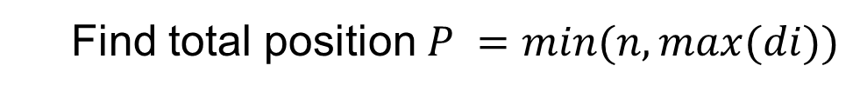
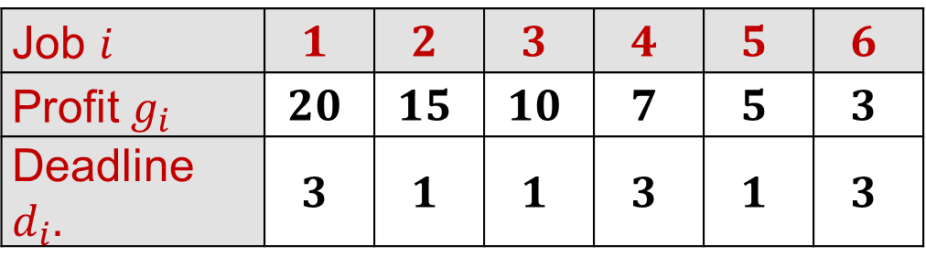
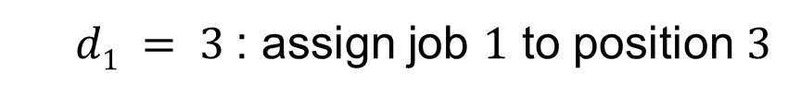
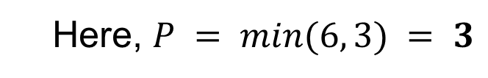
Job Scheduling with Deadlines - Example
Job $i$ | $$1$$ | $$2$$ | $$3$$ | $$4$$ | $$5$$ | $$6$$
Profit $g_{i}$ | $$20$$ | $$15$$ | $$10$$ | $$7$$ | $$5$$ | $$3$$
Deadline $d_{i}.$ | $$3$$ | $$1$$ | $$1$$ | $$3$$ | $$1$$ | $$3$$
Step 2:
Find total position $P =min⁡(n, max⁡(di))$
Here, $P = min⁡(6, 3) = 3$
P
1
2
3
Job selected
0
0
0
Step 3:
$d1 = 3$: assign job $1$ to position $3$
P
1
2
3
Job selected
0
0
J1

Slide 24
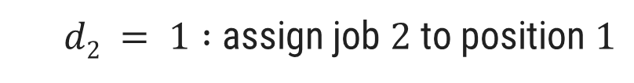

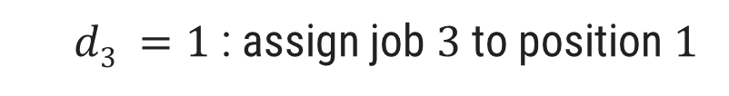
Job Scheduling with Deadlines - Example
Job $i$ | $$1$$ | $$2$$ | $$3$$ | $$4$$ | $$5$$ | $$6$$
Profit $g_{i}$ | $$20$$ | $$15$$ | $$10$$ | $$7$$ | $$5$$ | $$3$$
Deadline $d_{i}.$ | $$3$$ | $$1$$ | $$1$$ | $$3$$ | $$1$$ | $$3$$
Step 4:
$d2 = 1 :$assign job $2$ to position $1$
P
1
2
3
Job selected
J2
0
J1
Step 5:
$d3 =1$: assign job $3$ to position $1$
But position 1 is already occupied and two jobs can not be executed in parallel, so reject job 3

Slide 25
Job Scheduling with Deadlines - Example
Job $i$ | $$1$$ | $$2$$ | $$3$$ | $$4$$ | $$5$$ | $$6$$
Profit $g_{i}$ | $$20$$ | $$15$$ | $$10$$ | $$7$$ | $$5$$ | $$3$$
Deadline $d_{i}.$ | $$3$$ | $$1$$ | $$1$$ | $$3$$ | $$1$$ | $$3$$
Step 6:
$d4 =3 :$assign job $4$ to position $2$as, position $3$ is not free but position $2$ is free.
P
1
2
3
Job selected
J2
J4
J1
Now no more free position is left so no more jobs can be scheduled.
The final optimal sequence:
Execute the job in order 2, 4, 1 with total profit value 42.

Slide 26
Exercises – Home Work
Using greedy algorithm find an optimal schedule for following jobs with 𝒏=4.
Profits: (a, b, c, d) = (20,10,40,30) &
Deadline: (d₁, d₂, d₃, d₄) = (4, 1, 1, 1)
Using greedy algorithm find an optimal schedule for following jobs with 𝒏=5.
Profits: (a, b, c, d, e) = (100,19,27,25,15) &
Deadline: (d₁, d₂, d₃, d₄, d₅) = (2, 1, 2, 1, 3)

Slide 27
Job Scheduling with Deadlines - Algorithm
Algorithm: Job-Scheduling (P[1..n], D[1..n])
Sort all the n jobs in decreasing order of their profit.
Let total position P = min(n, max(d_{i}))
Each position 0, 1, 2…, P is in different set and T({i}) = i, for 0 ≤ i ≤ P.
Find the set that contains d, let this set be K. if T(K) = 0 reject the job; otherwise:
Assign the new job to position T(K).
Find the set that contains T(K) – 1. Call this set L.
Merge K and L. the value for this new set is the old value of T(L).

Slide 28
Thank You!

